Slide 1
Agenda For today
Questions
tKeepout Demo
Lab Overview

Slide 2
Building The Quadcopter Schematic
Dr. Steven Swanson
CSE176e/276e
swanson@cs.ucsd.edu

Slide 3
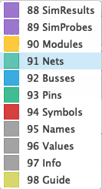
Schematic Layers in Fusion360
Fusion360 (and other tools) use layers to for different schematic information.
Nets – wires (electrical connections)
Pins – Connection points on symbols
Symbols – symbols
Names – symbol and pin names
Values – symbol values (e.g., resistance for resistors)
Info – Documentation
We won’t use the others

Slide 4
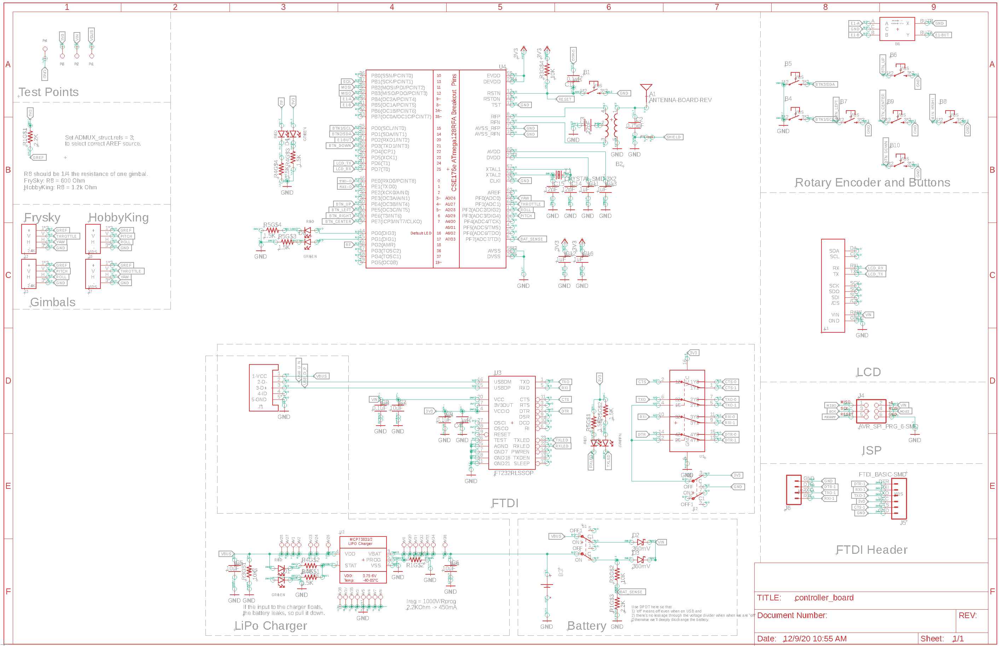
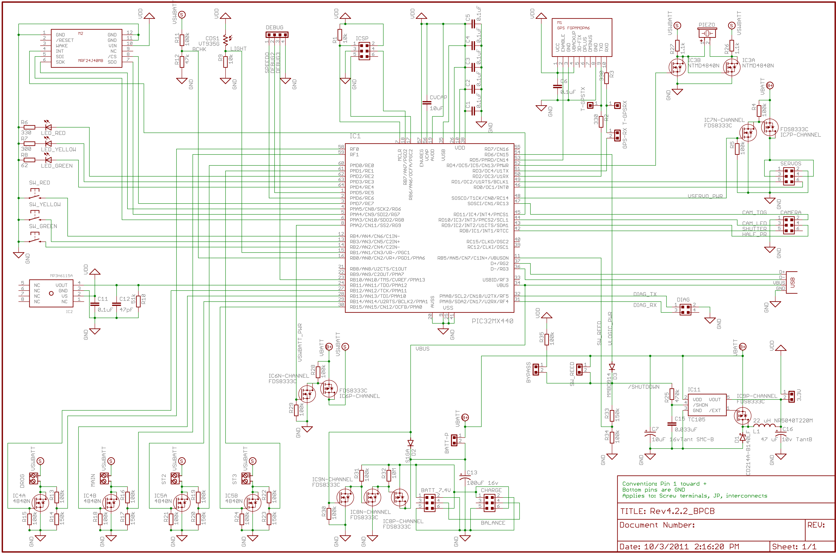

Slide 5
Schematics Goals
Determine what components your PCB will hold
Define the electrical connectivity between those components
Specify some metadata about the parts

Slide 6
Fusion360 Pitfalls
Always edit schematics with your grid set to 0.1” or 0.05” – ALWAYS!!!
Wires/pins can look connected but not be.
‘Wiggle’ parts to make sure wires move with them.
Check for the green dot.

Slide 7
Electrical Rules Check
This checks for common problems in schematics.
Make sure you understand the reason for the errors.
Fix them if you can.
Run it!

Slide 8

The Hardware You will Build

Slide 9
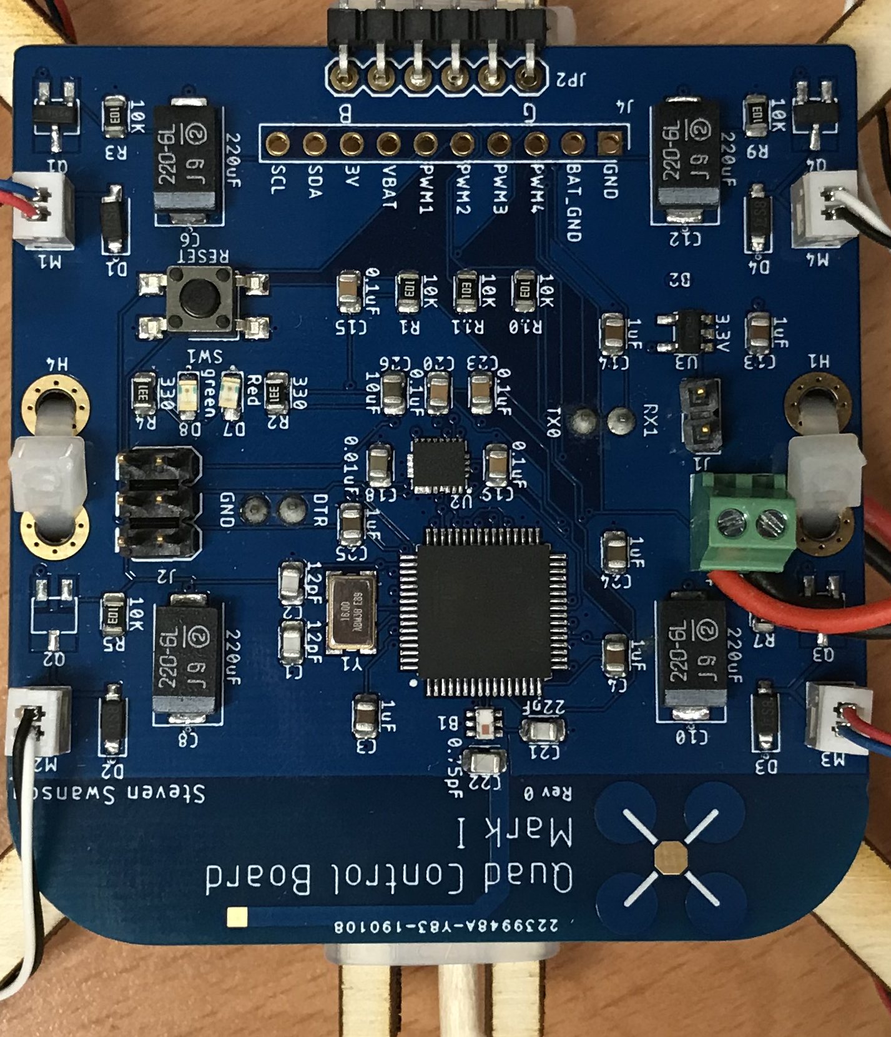
The Hardware You Will Build

Slide 10
Three Schematic Design Skills
Copy – You will manually copy the microcontroller circuit from a small breakout board that uses the same MCU.
Copy – you’ll copy the motor controller based on a schematic I provide.
Implement – You will look at the data sheet for the IMU and voltage regulator and implement the design it provides.
Design – you will add some LEDs to your design on your own.

Slide 11
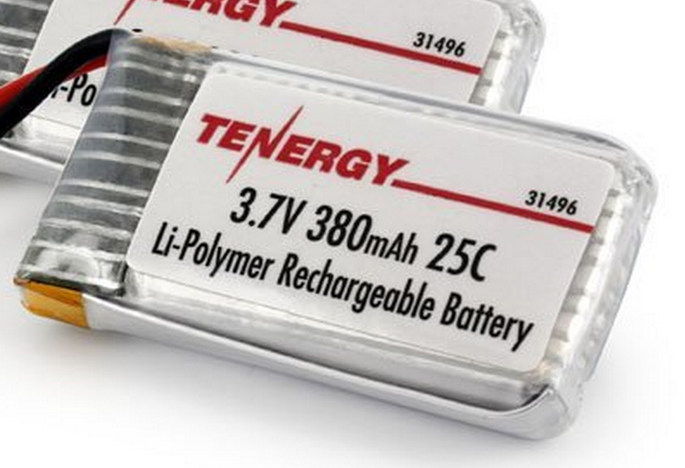
Power Supply
Lithium Polymer Battery
370 Mah
Max 9.25 Amps
Nominal voltage = 3.7-4.2V
Powers the motors directly
3.0V low dropout (LDO) voltage regulator
Powers the microcontroller and the IMU

Slide 12
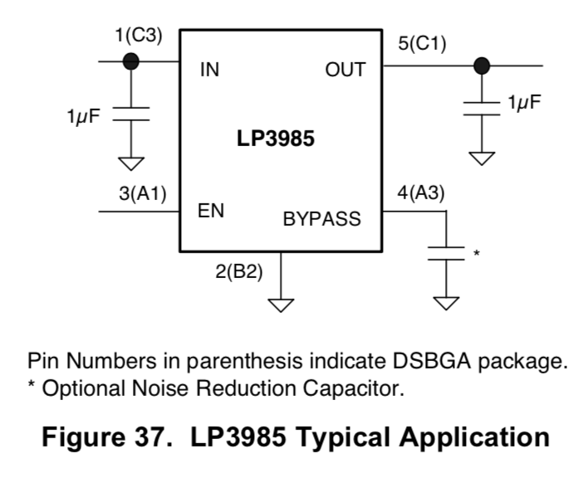
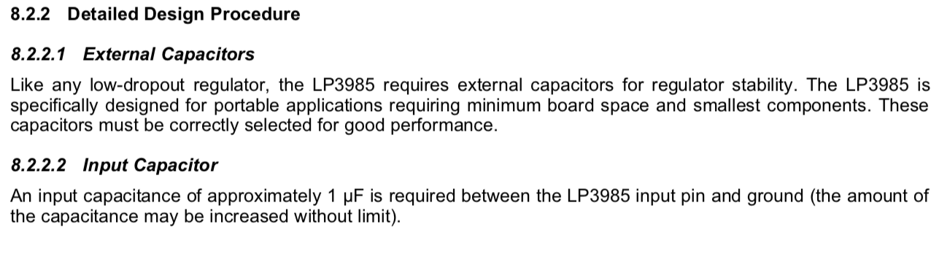
Voltage Regulator Datasheet

Slide 13
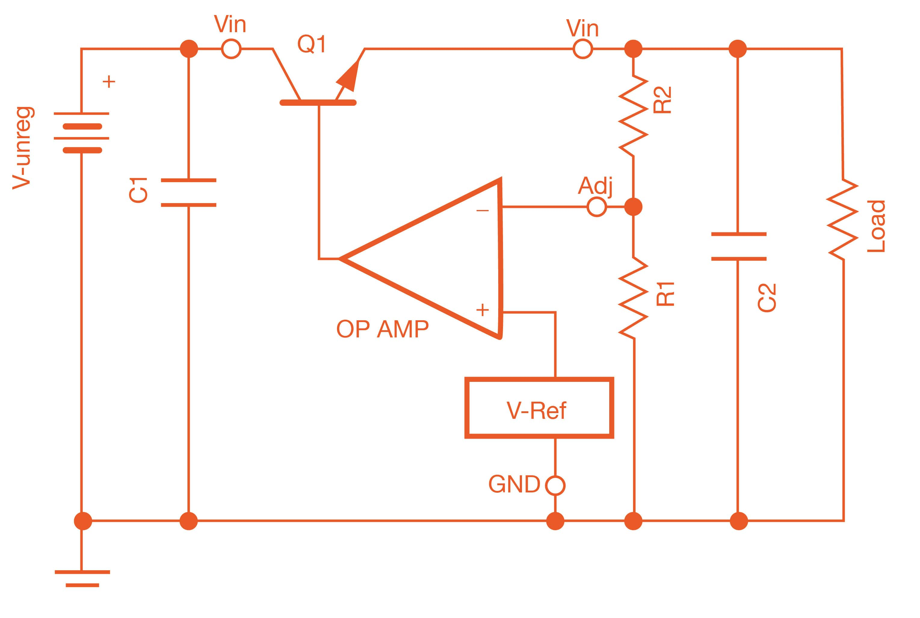
Linear Voltage Regulators
A variable resistor
V = IR
I is set by the load
Set R so that: Vin – Vref = I*R
The OP AMP compares Vout with Vref and adjust how “on” (low resistance) Q is
Q dissipates heat
P = I²R
Higher current -> lower resistance, lots of wasted power -> Hot regulator
The capacitors prevent oscillations.
Vout

Slide 14
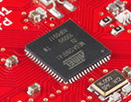
Flight Computer
ATmega128RFA1 microcontroller
Arduino compatible
16Mhz clock
128KB Flash
16KB SRAM
4096B EEPROM
2.4GHz radio (Compatible with Zigbee)

Slide 15
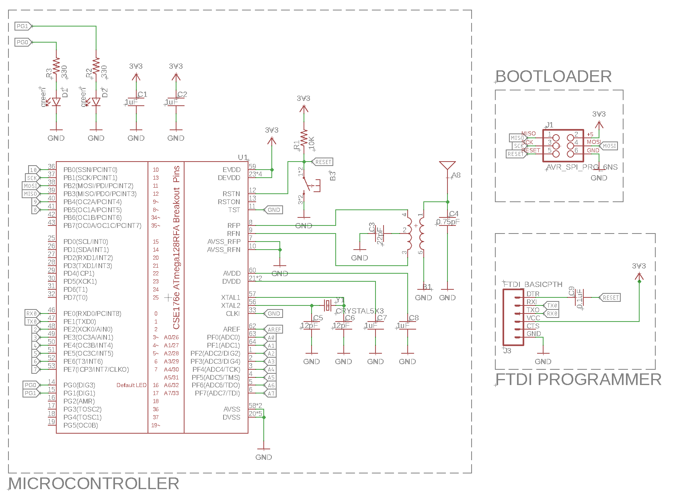
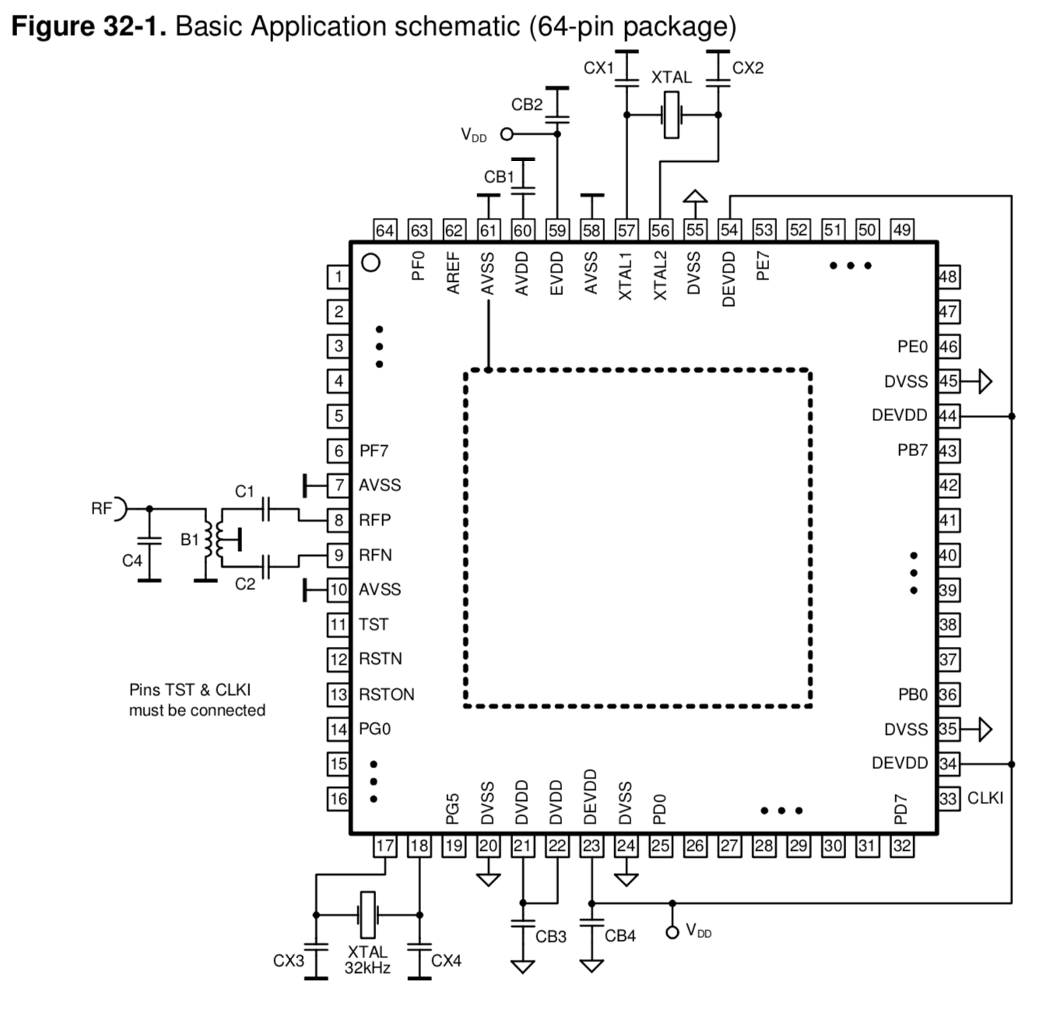
uController Datasheet and Reference Design

Slide 16
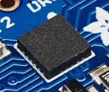
Inertial Measurement Unit
STMicro LSM9DS1
9-axis sensor
3-axis accelerometer
3-axis magnetometer
3-axis gyroscope
We will use the I2C interface

Slide 17
Inertial Measurement Unit
STMicro LSM6DSO
6-axis sensor
3-axis accelerometer
3-axis gyroscope
We will use the I2C interface

Slide 18
Why I²C?
Pins are precious!
They take up space
More pins → More expensive microcontrollers
Adding pins is hard
Might need a new microcontroller (if a larger, compatible one is available)
Significant board changes
Performance is often not that important
So
Use the minimum number of pins
Run them at relatively low bit rates.

Slide 19
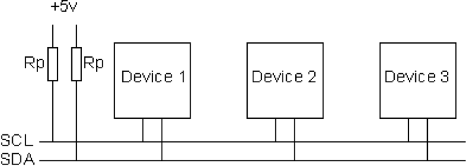
I2C Bus Architecture
I2C is cheap, easy and widely supported/deployed
Very easy to design for
Very low pin count
Two signals
SCL – Serial Clock (used for coordination and timing)
SDA – Serial Data (used for data and control signaling)
Both pulled up to VCC via a large resistor (10 kΩ in our design)

Slide 20
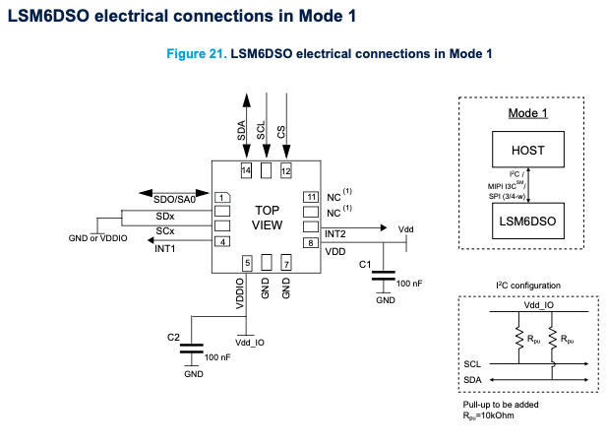
IMU Datasheet
Section 7.1

Slide 21
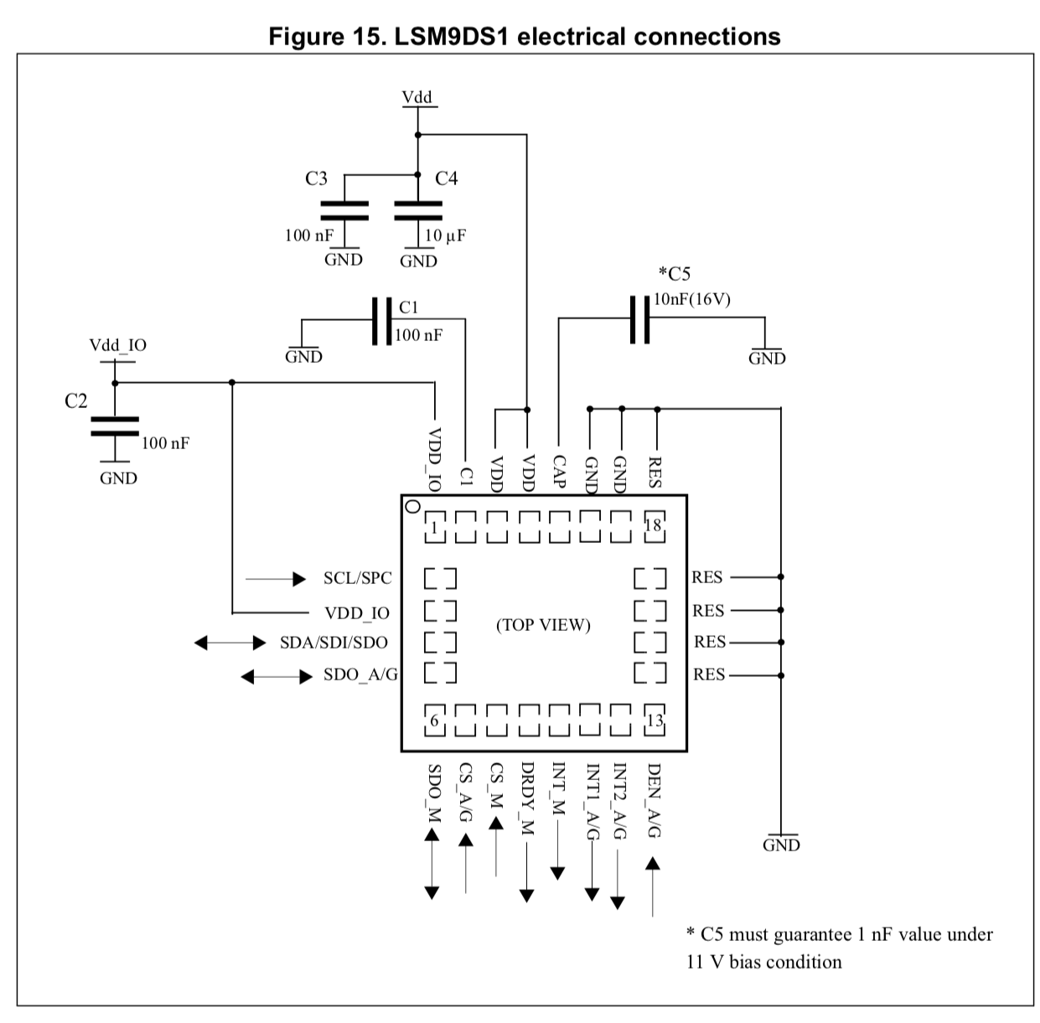
IMU Datasheet
Sections 4 and 5-5.1

Slide 22
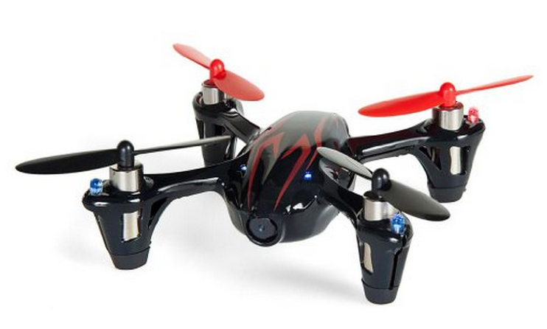
Motors and Props
DC brushed motors
They draw ~2A each.
Our batteries can do about 9A

Slide 23
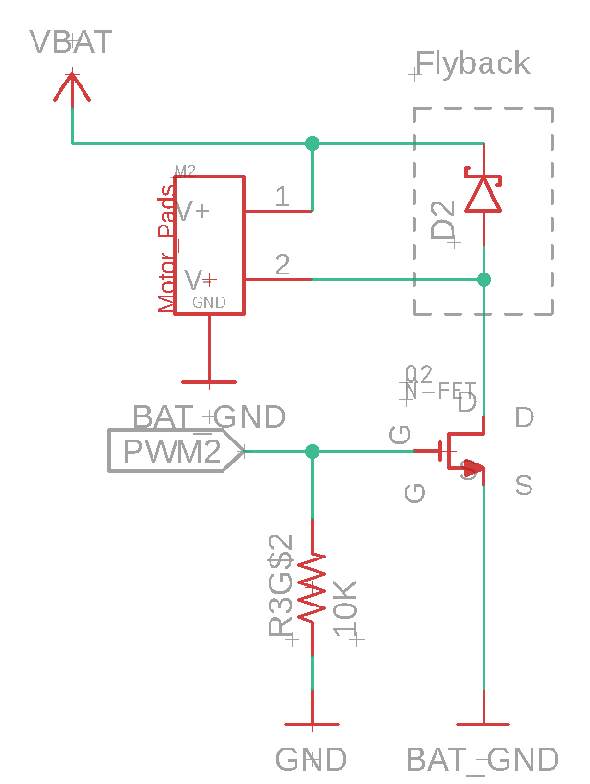
Motor Driver
Pulse-width modulation (PWM)-controlled MOSFET
The microcontroller will drive the MOSFET
The MOSFET will drive current to the motor.
A diode handles the inductive load from motor when it turns off (“flyback”)
Pull down resistor so it defaults to ‘off’.
Checkout the videos in the schedule

Slide 24
Pulse Width Modulation
Motor speed varies with voltage
Varying the voltage directly is hard
PWM varies the average voltage using a digital signals
Duty cycle: % of time signal is high
Cycle time: delay between rising edges (2ms on our MCU)
Frequency: 1/Cycle time (490Hz)
Our MCU has hardware for this
Accessed via analogWrite()
Cycle time = 2ms
Frequency = 490Hz
Check the video in the schedule

Slide 25
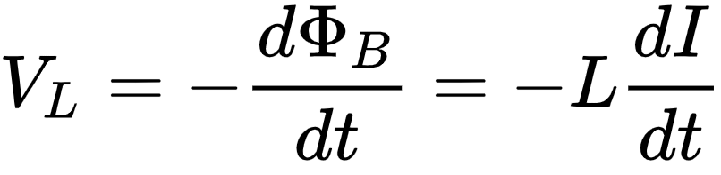
Motor Switching: Inductance and Flyback
Inductance -- Resistance to a change in current
Current takes time to start and stop flowing.
Imagine water flowing in a pipe when you turn off the faucet.
Formally, changing current (I) creates a voltage (V_{L}) proportional to the rate of change and the inductance (L)

Slide 26
Motor Switching: Inductance and Flyback
Motors are inductors (and resistors)
Motor voltage equation
Vm = voltage across the motor
I = Motor current
R = Motor resistance
L = Motor Inductance
dI/dt = rate of change of motor current
Resulting, large voltage will damage the switch
-75.8

Slide 27
Motor Switching: Inductance and Flyback
Add a ‘fly back diode’
When the switch is closed
No effect (reverse-biased)
When the switch is closed
Forward-biased
Routes current back into the motor

Slide 28
Managing Electrical Noise: Idealized Power Supply
Two supplies (VBAT and 3V3)
One ground
All wires have zero inductance and zero resistance.

Slide 29
Managing Electrical Noise: Realistic Power Supply
Wires have inductance and resistance
Lots of current, switching quickly
Result
Noisy power and ground
MCU resets
IMU resets

Slide 30
Managing Electrical Noise: Working Power Supply
Split the ground into two nets
GND – LDO, MCU, IMU
BAT_GND – Motor drivers
Limit inductance and resistance losses seen by GND
Connect them with a “wire bridge”
Put the the bridge near the negative battery terminal
Decoupling
Large decoupling caps on both regulated and unregulated power
Small decoupling caps (as specified in IMU and MCU datasheets)

Slide 31
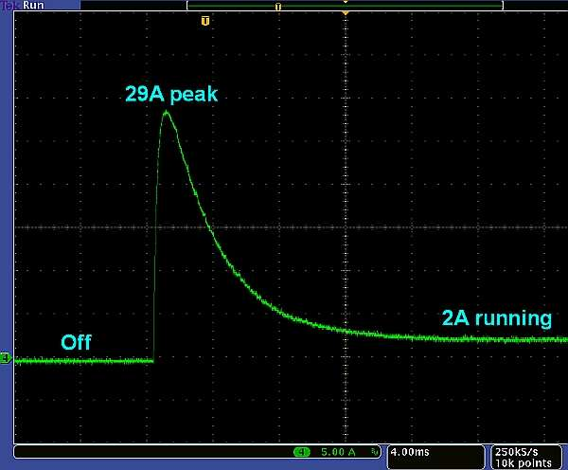
Back EMF
Maybe have a slide about back EMF and the current spike that occurs when you turn on the motor
The decoupling cap on VBAT and BAT_GND fixes this.
https://www.edn.com/getting-a-handle-on-brushed-dc-motor-current/

Slide 32
LEDs
You will add some LEDs to you quadcopter.
Three steps
Design your lighting scheme
Pick them on Digikey.com
Design the circuit to control them

Slide 33
LED Design
Functional
Which way is forward?
Status information
Pretty
Ground effects
Display your quad’s mood
Options
“indicator” LEDs draw a few mA
“lighting” LEDs can draw up to several amps.
Constraints
0.5 A maximum across all your LEDs

Slide 34
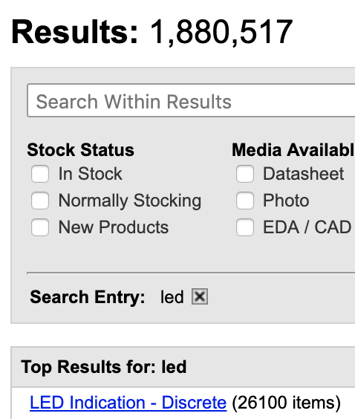
LED Selection
There are lots of LED
You will pick them on digikey
Must be at least 0805 (2mm x 1.25mm)
Available in quantities of 1
Cost < $1 per LED

Slide 35
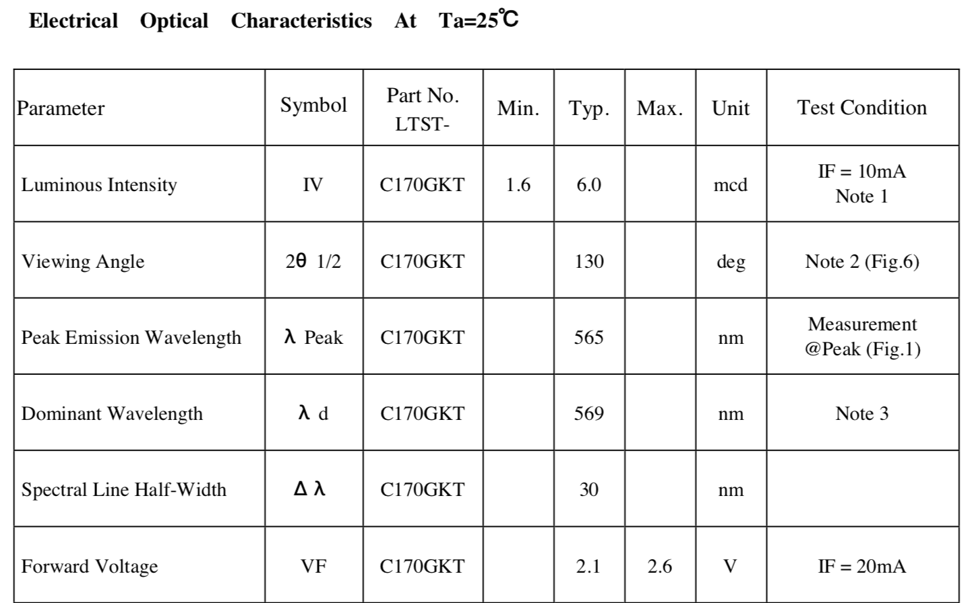
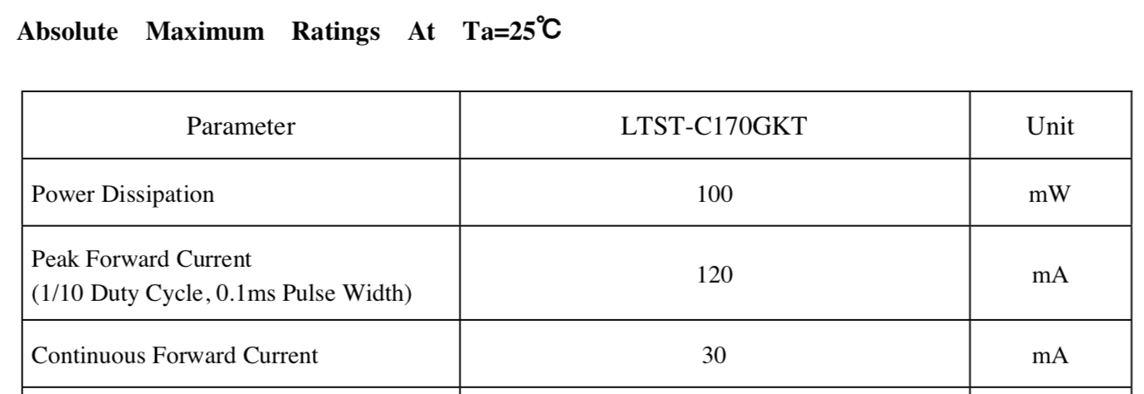
LED Datasheets
Key device parameters
Forward voltage: V_{f}
Color
Luminous intensity
Key absolute limits
Forward current

Slide 36
LED Circuit design
Ohm’s Law : V = IR
The forward voltage (V_{f}) across an LED is (roughly) fixed
Driving the LED at > V_{f} will (maybe) burn it out.

Slide 37
Limiting Current
Ohm’s Law : V = IR
The forward voltage (V_{f}) across an LED is (roughly) fixed
Add a resistor to limit current.

Slide 38
Set Your Brightness Carefully
Indicator LEDs do not need to be driven hard
The red LED on the FCB uses a 510Ω resistor
Vf = 2V; Vcc = 3.3
I = V/R => I = (3.3-2.0)/510 = 2.5mA
The maximum brightness (@30mA) is 12x higher
They can easily become blindingly bright.
LED Power
LED power roughly translates to brightness
Power = Current * Voltage (P = IV)
The Red LED dissipates 2.5mA * 2V = 5mW.
Keep that in mind as a reference.

Slide 39
Controlling your LEDs
Drive directly with MCU pin
Good for indicators
< 10mA/LED
Use a PWM pin to make them dimmable
Drive via MOSFET (digital or PWM)
Good for bright LEDs
<500mA total.
You can run several LEDs in series if V_{f} is low enough.
You can run them in parallel too, but brightness will vary.
You can also just wire them to power switch through Vreg Enable (300mA max).

Slide 40
Turning in your LED design
Pick your LEDs
Commit your datasheets
Create the Fusion360 library (including any resistors your need)
Document your LED design using text in `Info` layer.
I will reject if you don’t do this.

Slide 41
Demo
Schematic organization
Connection via named nets
Using ‘show @’ to check connectivity
Explain how Eaglint checks things (path based patterns).

Slide 42
Building a Schematic Demo
Dr. Steven Swanson
CSE176e/276e
swanson@cs.ucsd.edu

Slide 43
Common Schematic Problems
Dr. Steven Swanson
CSE176e/276e
swanson@cs.ucsd.edu

